Slide 1
Deep Learning Architecture
Ali saleh

Slide 2
Agenda
What is Deep Learning
Brief History of deep learning
Convolution Deep belief networks for detection and classification
Other successful Deep learning Methods
Criticism to Deep learning methods
Conclusion

Slide 3
What is Deep Learning
Trainable Feature detector units arranged in hierarchy of layers
Lower layers detect simple features (Local Features)
Higher layers detect complex features (Global Features)
Each layer provide it’s output as input for the next layer

Slide 4
Brief History of Deep Learning
Pandemonium architecture (late 1950s)
    Inspired by Hubel and Wiesel work on vision system
    Four different groups of detectors each assigned to a recognition stage (Data, Feature, Cognitive, Decision)
    Was able to recognize characters
    Needed large number of training exambles

Slide 5
Brief History of Deep Learning
Neocognitron (Fukushima 1980s)
  Alternate C-Cells and S-Cells Layers
  S-Cells are for feature extraction
  C-Cells are for position tolerance
  Learning is only for the S-Cells planes.

Slide 6
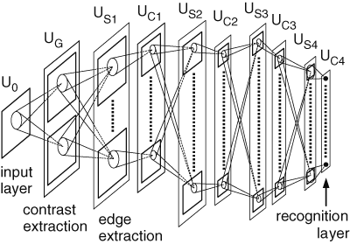
Brief History of Deep Learning
Neocognitron (Fukushima 1980s)

Slide 7
Brief History of Deep Learning
Deep belief network (Hinton 2006)
  Un-supervised training for a Neural Network
  The network is a set of RBMs stacked one over the other
  Training one layer at a time
  Use the output of each layer as input to the next layer
  Gave 1.25% error rate for the MNIST dataset
  Training time was about 1 week

Slide 8
Brief History of Deep Learning
Autoencoders for dimensionality reduction (Hinton 2006)
  Similar technique like the deep belief networks.
  Backpropagation is used through the whole system to fine tune the weights
  Pre-training gives better results.
  Give better results Than PCA variants on MNIST dataset.

Slide 9
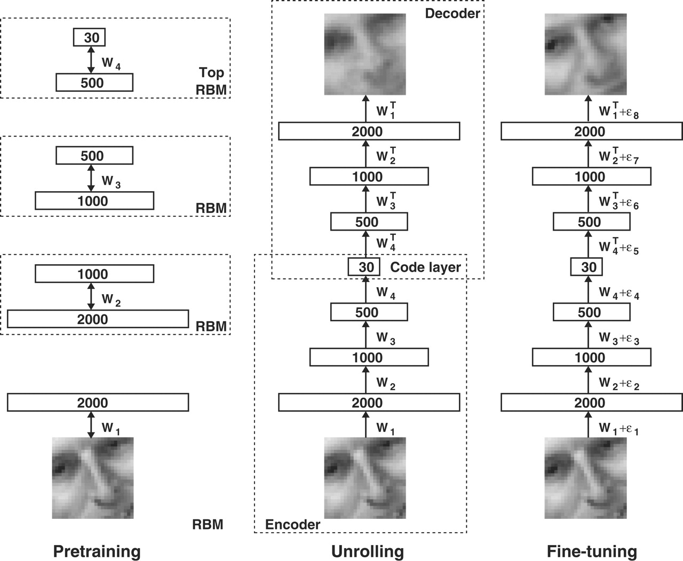
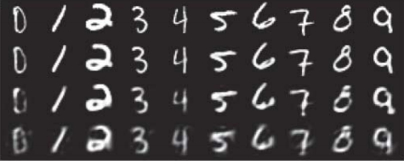
Brief History of Deep Learning

Slide 10
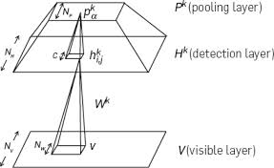
Convolution Deep belief networks for detection and classification
Stable to the change of the object place in the image
Uses CRBMs instead of RBMs
Weights are shared among the whole layer
Allows detectors to learn the same object in different places
Max pooling is used to help tolerating changes in position of features
Experiment showed that max pooling makes the algorithm 10 times faster
Uses layer by layer training as in the original model.
A single CRBM

Slide 11
Convolution Deep belief networks for detection and classification
Experimental results
  Caltech-101 object classification task
  MNIST Dataset
    2 layers of CRBMS to prepare a feature vector
    SVM classifier over the features gives 0.82% error rate.
 | CDBN | shape-context | SIFT
15 image per class | 57.7 ±1.5% | 59.0 ± 0.56% | 54.0%
30 image per class | 65.4 ± 0.5% | 66.2 ± 0.5% | 64.6%

Slide 12
Other successful Deep learning Methods
Google Brain (detecting cats and human faces in random videos)
Facebook Ads improvement
Microsoft speech recognition
Microsoft Bing speech translation

Slide 13
Criticisms to Deep learning methods
lack of theory for most of the methods.
Most results are experimental not theoretical.
Neural Networks takes a long time for training.

Slide 14
References
A Fast Learning Algorithm for Deep Belief Nets : Geoffrey E. Hinton et al
Learning multiple layers of representation : Geoffrey E. Hinton
Learning Deep Architectures for AI :Yoshua Bengio
Neocognitron: A Self-organizing Neural Network Model for a Mechanism of Pattern Recognition Unaffected by Shift in Position: Kunihiko Fukushima
Building High-level FeaturesUsing Large Scale Unsupervised Learning : Quoc V. Le et al
Reducing the Dimensionality of Data with Neural Networks G. E. Hinton and R. R. Salakhutdinov
Representation Learning: A Review and New Perspectives : Yoshua Bengio, Aaron Courville, and Pascal Vincent
Convolutional Deep Belief Networks for Scalable Unsupervised Learning of Hierarchical Representations :Honglak Lee et al

